Slide 1
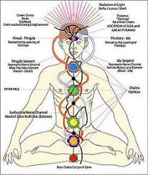
THE CHAKRA TABLE
Yerai Oliveras
Notes:
Good Evening Montrose. Scientific Exploration is based on the fundament that new information reviews, challenges and remodels theories leading to a progress in understanding. So in this way what lies outside of the scientific realm is awaiting information. The idea of Energy Centers aka Chakras is not a new concept, but perhaps it is new to Western science. What I will share is my perspective.

Slide 2

Notes:
Love is the ETERNAL SOURCE OF ENERGY | When the BODY is HEALTHY EVERYTHING IS BEAUTIFUL | When the BODY is Sick and Tired it requires ENERGY from the SUPREME SOURCE | The BRAIN holds the CONNECTION to the SOURCE OF ETERNAL ENERGY but the ORGANS contain the CHANNELS | The KEY is DISPLAYED OPEN | Medicine is the Art of Source of Love | ENERGY FUNCTION ENERGY FUNCTION ENERGY FUNCTION ENERGY FUNCTION ENERGY FUNCTION ENERGY | Every Organ Integrates the SOURCE | When the Body is HEALTHY EVERY ORGAN FLUXES | When the BODY is SICK the Organs work together to FUNCTION | SEXUAL ENERGY IS FUNCTIONAL FROM EVERY ORGAN INTEGRATIVE TO TRUNION | HEALTHY SEXUAL ENERGY CAN PROCEED FROM EVERY ORGAN | THOUGHTS | COMMUNICATION | STABILITY | DIET | METABOLISM | SEX | Integrative Descriptions Functionalize to Activate Every Organ

Slide 3
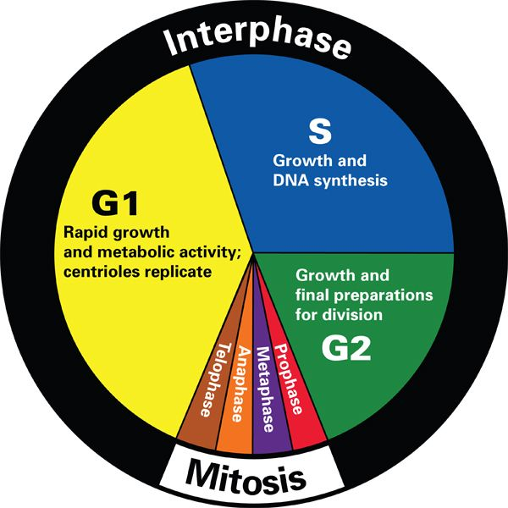

Slide 4
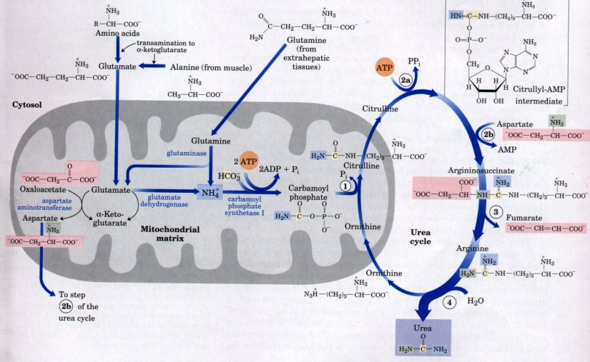
Notes:
SPACIAL SPECIAL INTEGRATION

Slide 5
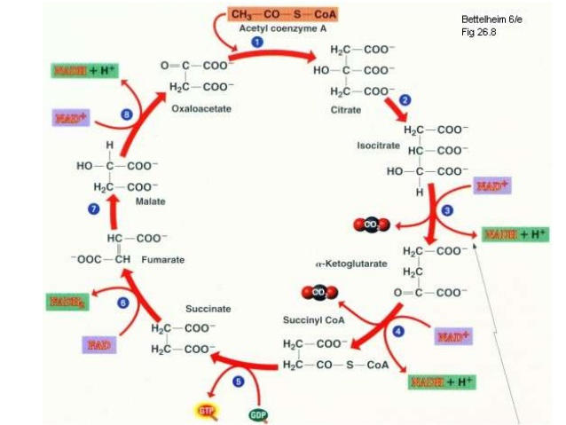

Slide 6
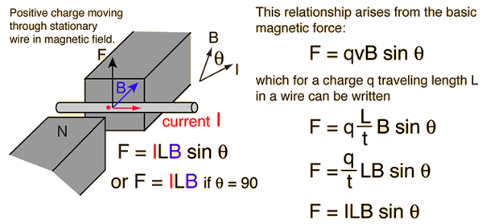
Notes:
Lorentz-Heaviside Formula

Slide 7
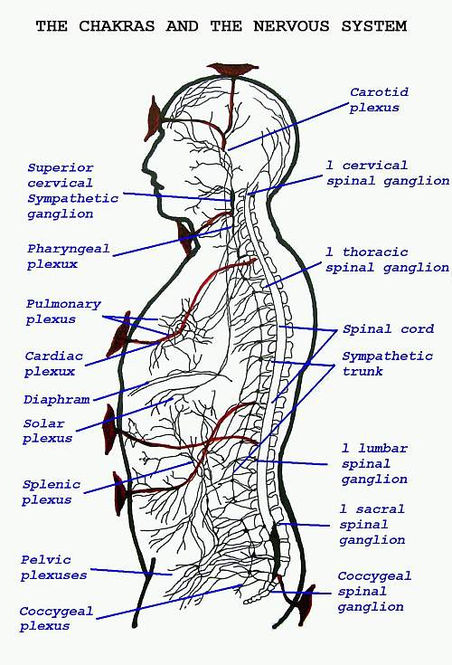
Notes:
One gauss equals 1×10⁻⁴ tesla (100 μT), so 1 tesla = 10,000 gauss.
The tesla (symbolized T) is the standard unit of magnetic flux density. It is equivalent to one weber per meter squared (1 Wb. m ⁻² ).
The weber is commonly expressed in a multitude of other units:
where Wb = weber,
V = volt,
T = tesla,
J = joule,
m = metre,
s = second,
A = ampere,
H = henry,
Mx = maxwell.

Slide 8
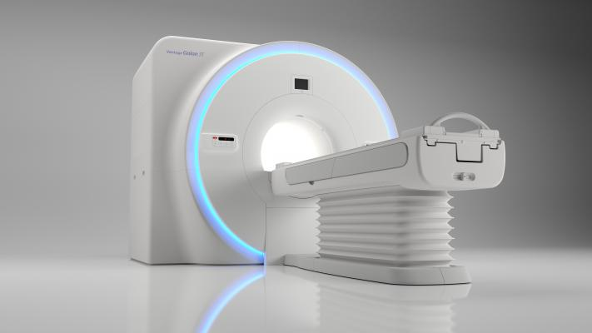

Slide 9
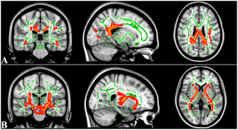

Slide 10
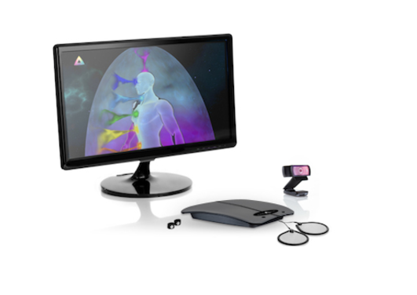

Slide 12
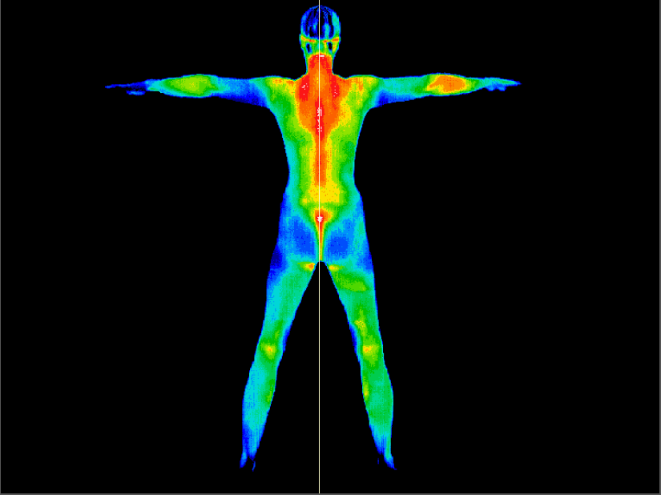

Slide 13
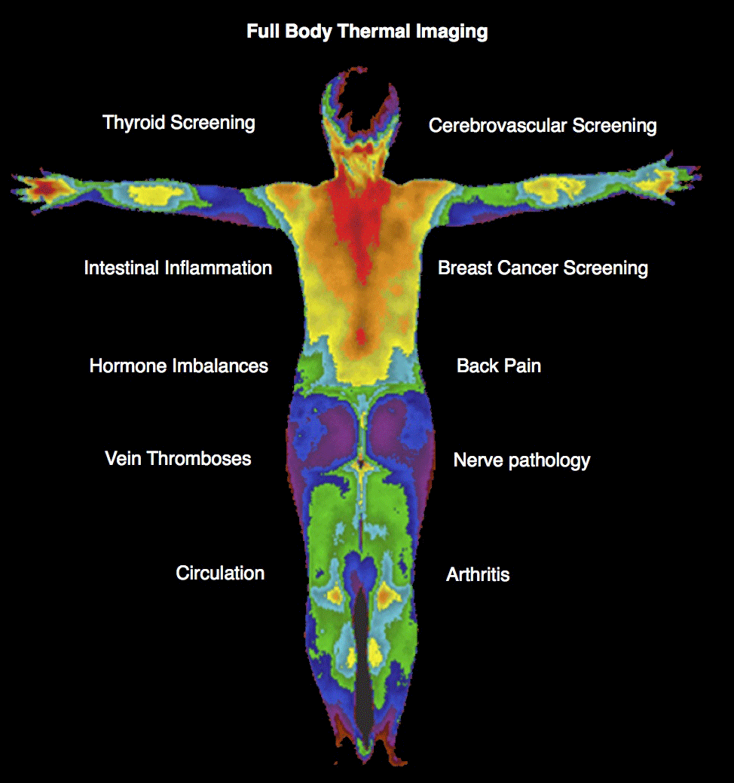

Slide 14


Slide 15
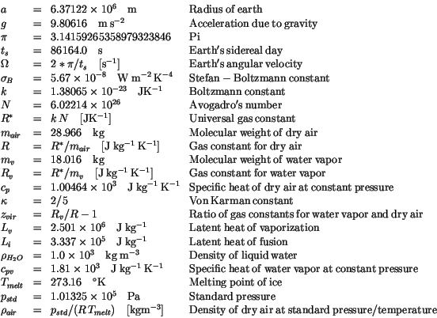
Physical Constants of the Universe

Slide 16
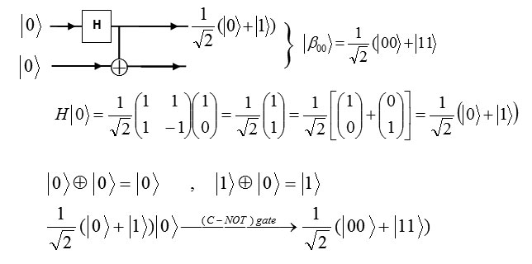

Slide 17
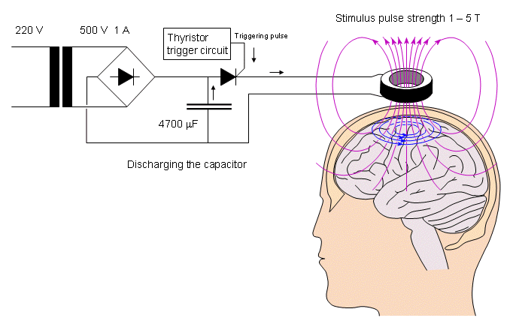

Slide 18
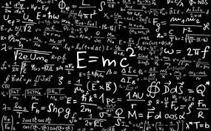
Notes:
SUPRA SUTURA ENERGY | EVERY EQUATION SOLVED FOR LOVE | IN LOVE FOUND TRUE MEANING | IN MUSIC IN SOUND IN ALL THE ARTS IN ALL THE SENTENCES IN ALL FORMS
SCHOPENHAUER | [|]

Slide 19
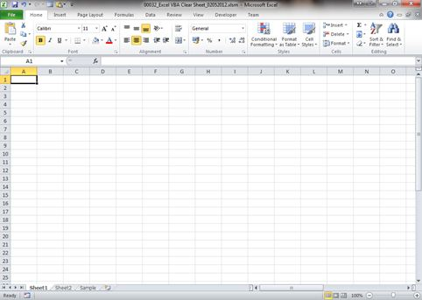

Slide 20
CONTACT INFORMATION
Yerai Oliveras Sánchez
Chemical Engineer Chemist
www.syntheticforest.com
19394564949
yeraioliveras@gmail.com
yerai@syntheticforest.com

